Slide 1


Department of Computer science and Engineering
Batch Number - 19PB22
Major project
On
Real Time Sign Language Recognition using Transfer Learning
Submitted by
G Harsha vardhan - 19P61A0566
G Harsha vardhan Rao - 19P61A0575
S Harshith - 19P61A0581
Under the Guidance of
Supervisor Name - Mr. G Anil Kumar
Coordinator Name - Mr. G Srikanth Reddy

Slide 2

OUTLINE
ABSTRACT
EXISTING SYSTEM
PROPOSED SYSTEM
UML DIAGRAMS
METHODOLOGY
RESULTS
REFERENCES
CONCLUSION
THANK YOU

Slide 3
ABSTRACT
Every day we see many people who are facing illness like deaf, dumb and blind etc. They face difficulty to interact with others. Previously developed techniques are all sensors based and they didn’t give the general solution. The major goal of the proposed project is to create a cost-effective system that uses Smart Gloves to provide voice to the silent. Using a flex sensor and a microprocessor, the suggested method converts sign language into text and speech. It means that communication between two communities will not be hampered by the use of smart gloves.

Slide 4
Existing system
Sign Language Recognition System using Convolutional Neural Network and Computer Vision .
The Disadvantages are :
Highly Expensive.
Even if performed by any other ML techniques and With online, they Require tons of images to train for a single gesture .

Slide 5
Proposed system
The deaf person should submit a gesture or sign image to the system in the proposed system.
The system uses a mat lab image processing technique to analyse the sign input and classifies it for recognised identification. When the input image matches the specifi ed dataset, it then starts the voice media through the system.
In addition, the output will be displayed in text format. This is a working prototype for the conversion of sign language to speech and text.

Slide 6
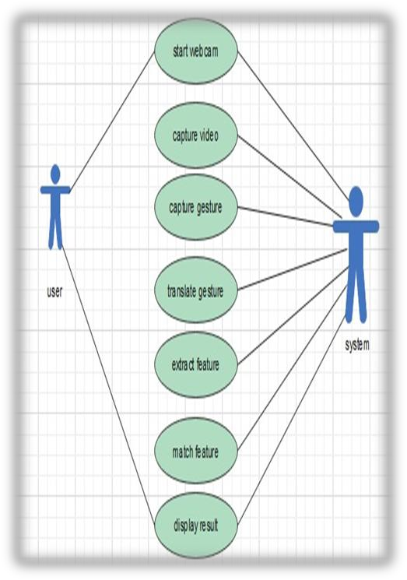
Usecase diagram of sign language recognition System

Slide 7
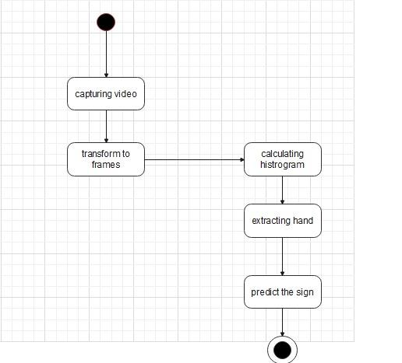
ACTIVITY diagram of sign language recognition system

Slide 8



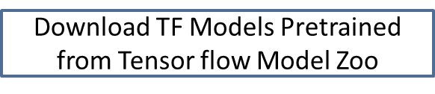
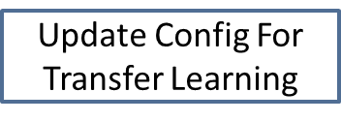
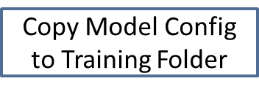
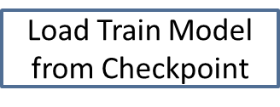
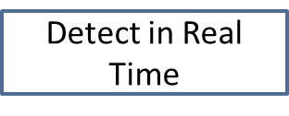

METHODOLOGY

Slide 9
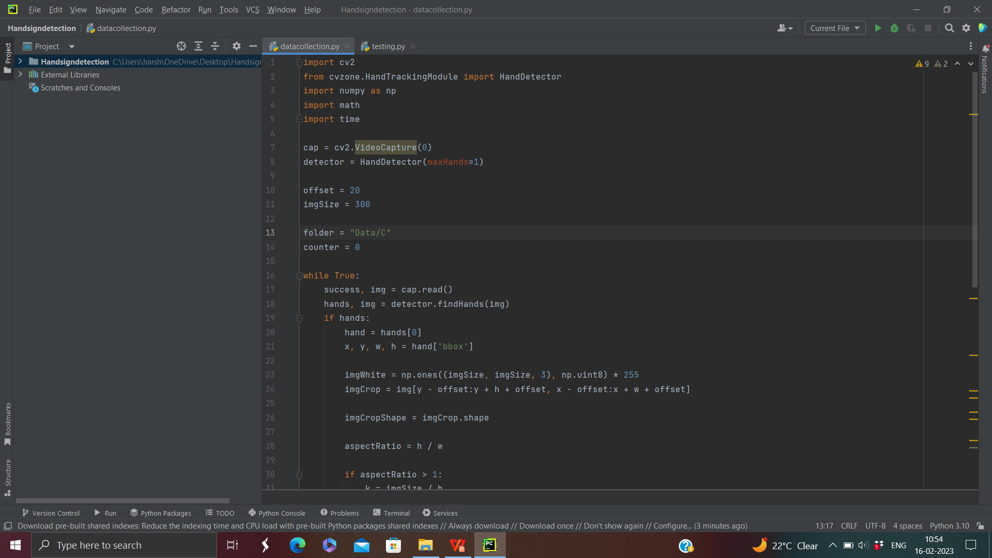
Implementation

Slide 10
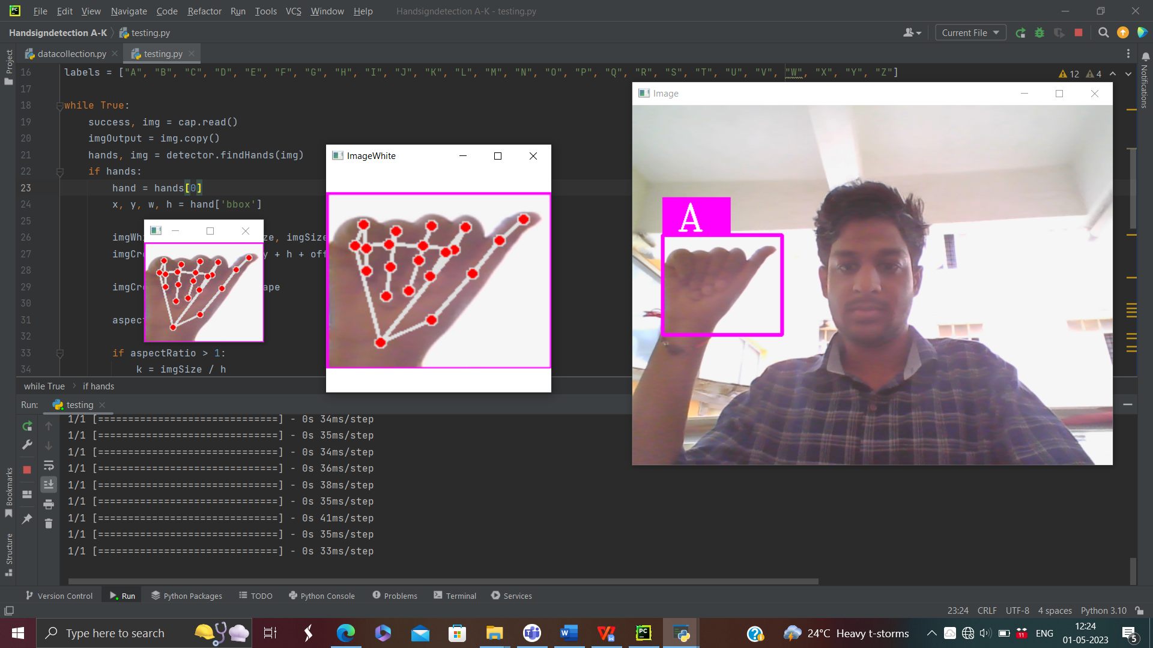
REsult

Slide 11
CONCLUSION
Sign languages are kinds of visual languages that employ movements of hands, body, and facial expression as a means of communication. Sign languages are important for specially-abled people to have a means of communication.
In this paper, it has been done by TensorFlow object detection API. The system has been trained on the Indian Sign Language alphabet dataset. The system detects sign language in real-time. For data acquisition, images have been captured by a webcam using Python and OpenCV which makes the cost cheaper. Though the system has achieved a high average confidence rate, the dataset it has been trained on is small in size and limited.

Slide 12
REFERENCES
[1] Sharma P & Anand R. S, A Comprehensive Evaluation of Deep Models and Optimizers for Indian Sign Language Recognition, Graphics and Visual Computing. (2021)
[2] Wadhawan A & Kumar P, Deep Learning-Based Sign Language Recognition System for Static Signs, Neural Computing and Applications.
[3] Mohammed A. A. Q, Lv J, Islam M. S & Sang Y, Multi-Model Ensemble Gesture Recognition Network for High-Accuracy Dynamic Hand Gesture Recognition, Journal of Ambient Intelligence and Humanized Computing. (2022)
[4] Joudaki S & Rehman A, Dynamic Hand Gesture Recognition of Sign Language Using Geometric Features Learning, International Journal of Computational Vision and Robotics.

Slide 13


